Slide 1
Act 1:8 But you shall receive power when the Holy Spirit has come upon you; and you shall be witnesses to Me in Jerusalem, and in all Judea and Samaria, and to the end of the earth."

Slide 2
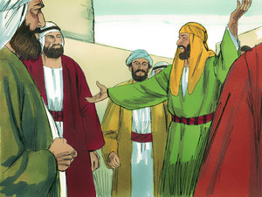
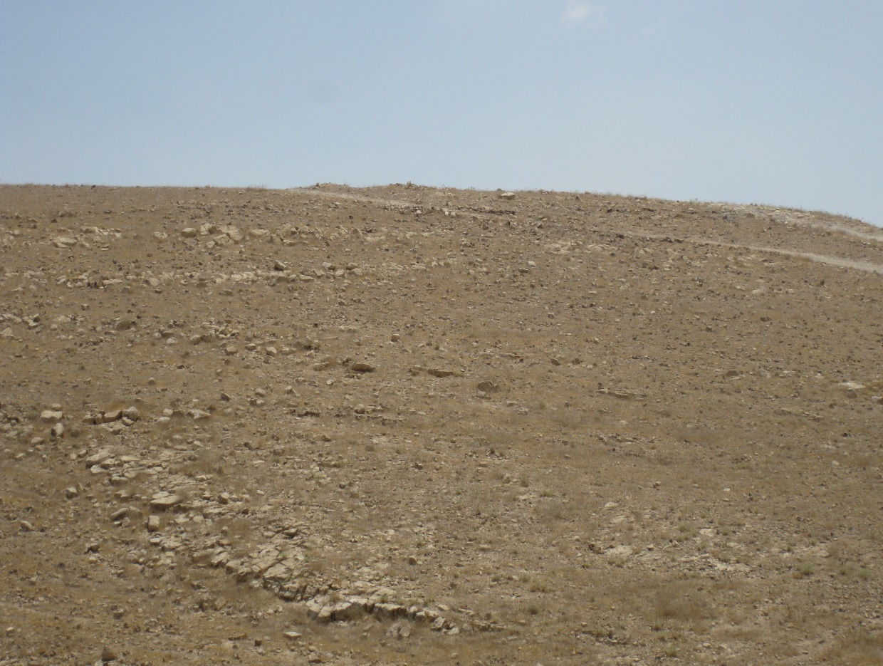
From Joy to the Desert
Acts 8:26-40

Slide 3
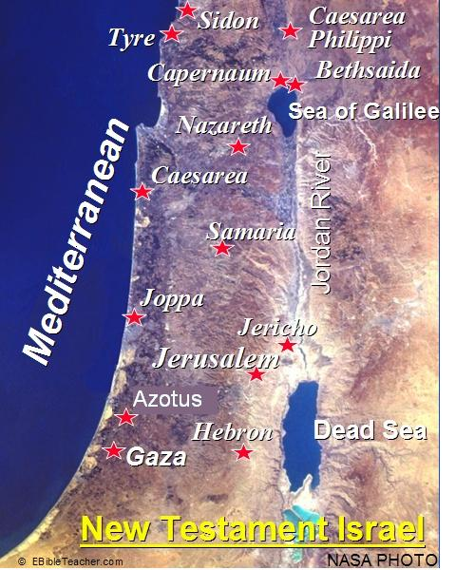
An Angelic Word
Act 8:26 Now an angel of the Lord spoke to Philip, saying, "Arise and go toward the south along the road which goes down from Jerusalem to Gaza." This is desert.

Slide 4
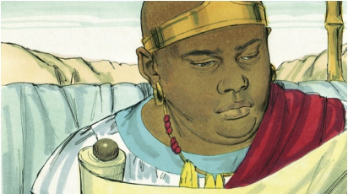
A Divine Appointment
Act 8:27 So he arose and went. And behold, a man of Ethiopia, a eunuch of great authority under Candace the queen of the Ethiopians, who had charge of all her treasury, and had come to Jerusalem to worship Act 8:28 was returning. And sitting in his chariot, he was reading Isaiah the prophet.

Slide 5
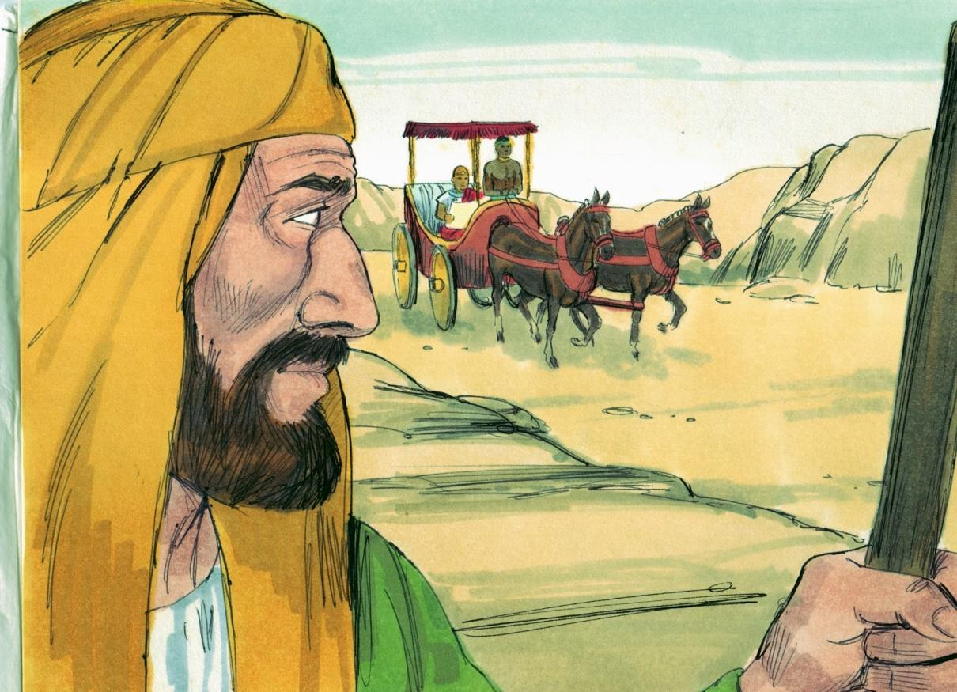
A Word From The Holy Spirit
Act 8:29 Then the Spirit said to Philip,
"Go near and overtake this chariot."

Slide 6
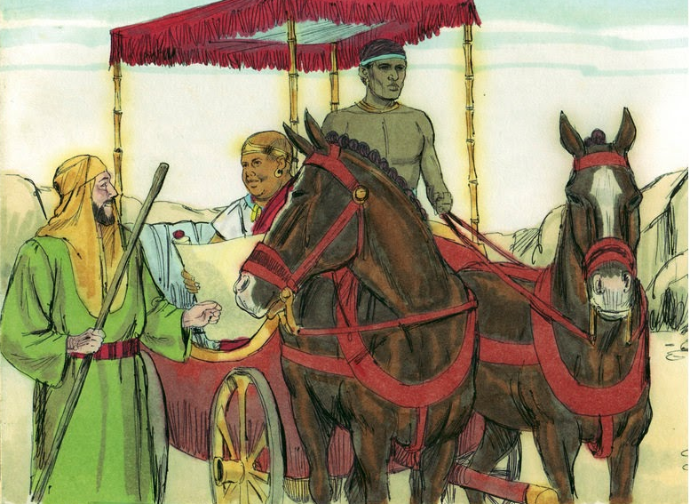
Philip’s Prompt Response
Act 8:30 So Philip ran to him, and heard him reading the prophet Isaiah, and said, "Do you understand what you are reading?"

Slide 7
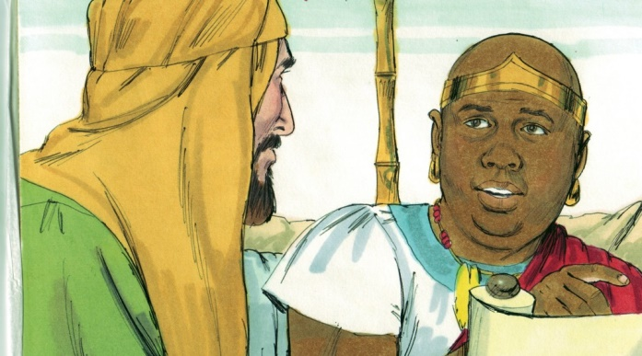
They Can Only Believe If Told
Act 8:31-33 And he said, "How can I, unless someone guides me?" And he asked Philip to come up and sit with him. (32) The place in the Scripture which he read was this: "he was led as a sheep to the slaughter; and as a lamb before its shearer is silent, so he opened not his mouth. (33) in his humiliation his justice was taken away, and who will declare his generation? for his life is taken from the earth.“ (see Isaiah 53:7,8)

Slide 8
Jesus, The Centrality Of Our Message
Act 8:34 So the eunuch answered Philip and said, "I ask you, of whom does the prophet say this, of himself or of some other man?“ Act 8:35 Then Philip opened his mouth, and beginning at this Scripture, preached Jesus to him.

Slide 9
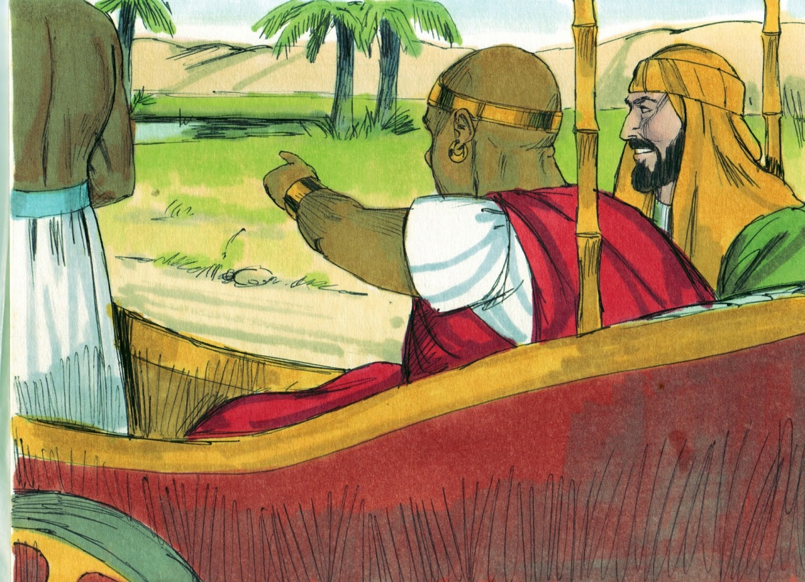
The Right Kind Of Faith ?
Act 8:36-37 Now as they went down the road, they came to some water. And the eunuch said, "See, here is water. What hinders me from being baptized?" (37) Then Philip said, "If you believe with all your heart, you may." And he answered and said, "I believe that Jesus Christ is the Son of God."

Slide 10
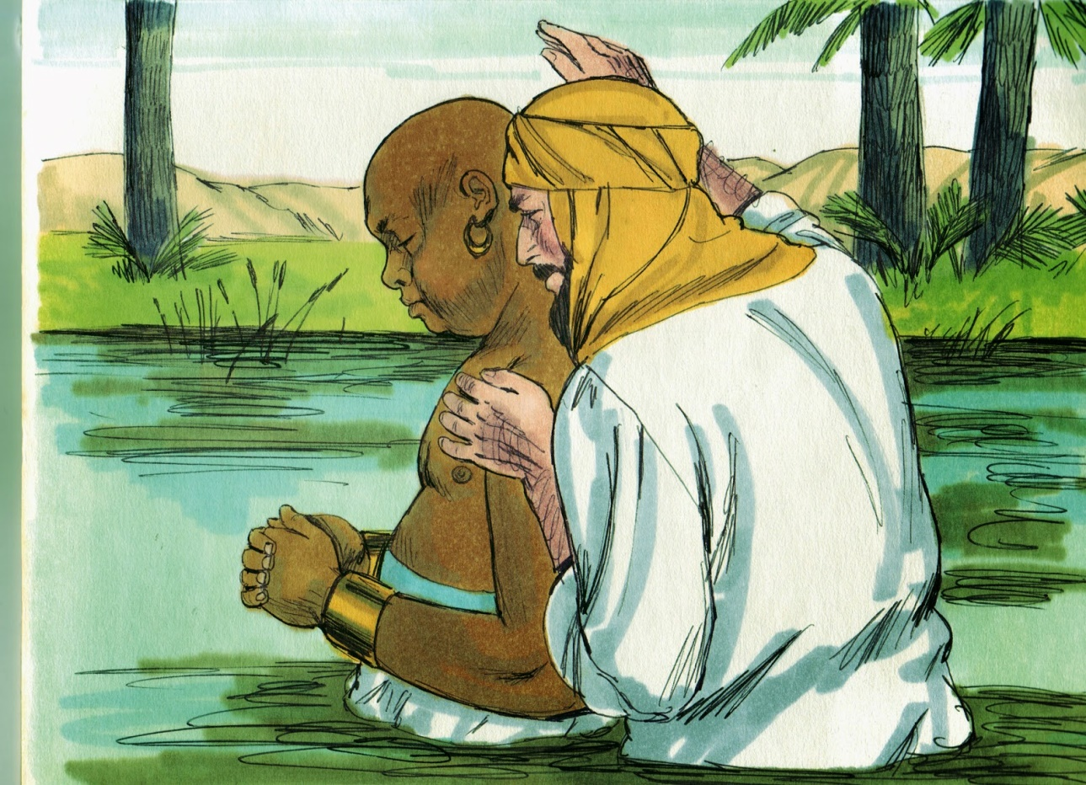
The Eunuch’s Obedience
Act 8:38 So he commanded the chariot to stand still. And both Philip and the eunuch went down into the water, and he baptized him.

Slide 11
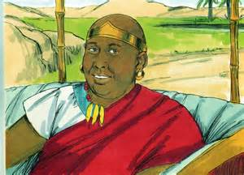
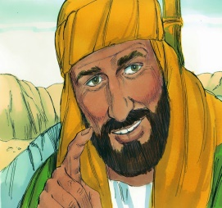
Philip Got “Harpazoed/Raptured”
Act 8:39 Now when they came up out of the water, the Spirit of the Lord caught Philip away, so that the eunuch saw him no more; and he went on his way rejoicing.
1Th 4:17 Then we who are alive and remain shall be caught up (harpazō) together with them in the clouds…

Slide 12
(40) But Philip was found at Azotus. And passing through, he preached in all the cities till he came to Caesarea.

