Slide 1
Sent, Went and Found
Acts 9:32-43

Slide 2
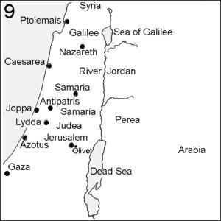
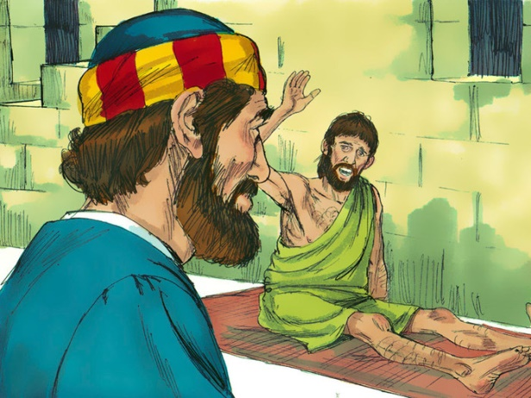
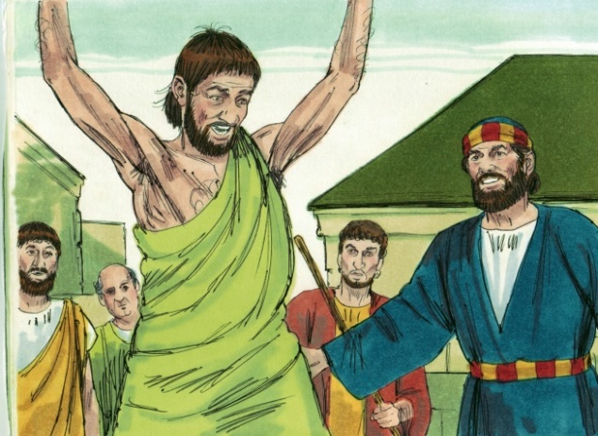
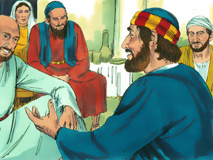
Act 9:32 Now it came to pass,
as Peter went through all parts of the
country, that he also came down to the
saints who dwelt in Lydda.
(33) There he found a certain man named Aeneas,
who had been bedridden eight years and
was paralyzed. (34) And Peter said to him, "Aeneas, Jesus the Christ heals you. Arise and make your bed." Then he arose immediately. (35) So all who dwelt at Lydda and Sharon saw him and turned to the Lord.

Slide 3
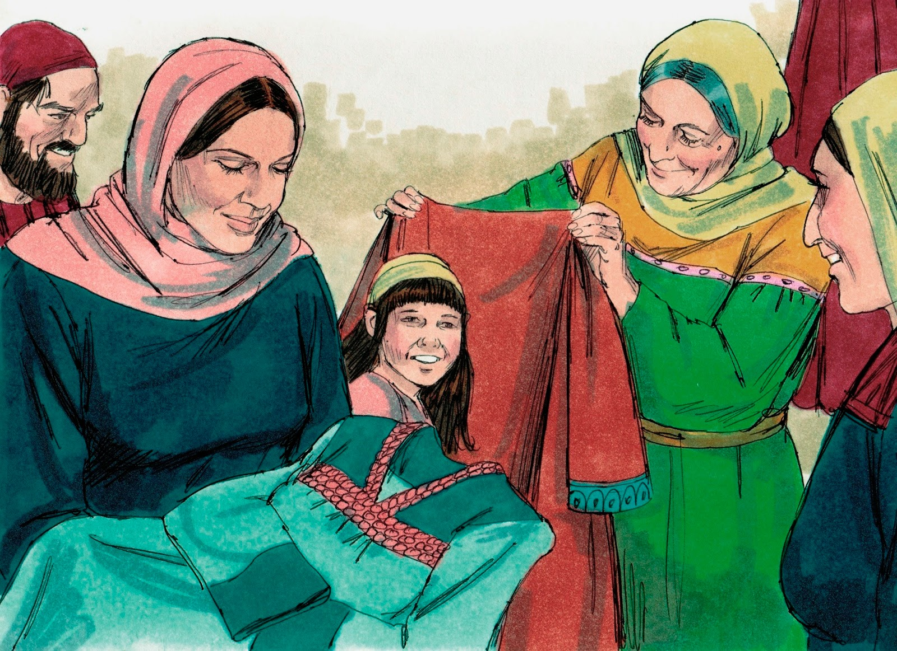
Act 9:36 At Joppa there was a certain disciple named Tabitha, which is translated Dorcas. This woman was full of good works and charitable deeds which she did.

Slide 4
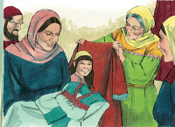
Aramaic/Tabitha = Greek/Dorcas = Interpretation/Gazelle
She was a disciple who lived in Joppa
Full of good works
Benevolent Giver
[This is] a faithful saying, and these things I will that you affirm constantly, that they which have believed in God might be careful to maintain good works . These things are good and profitable unto men. Titus 3:8
Let your light so shine before men, that they may see your good works , and glorify your Father which is in heaven. Jn. 5:16
In like manner also, that women adorn themselves in modest apparel, with shamefacedness and sobriety; not with braided hair, or gold, or pearls, or costly array; 10 But (which is proper for women professing godliness) with good works. I Tim. 2:9,10
And let us consider one another to provoke unto love and to good works : Heb. 10:24
Whether therefore ye eat , or drink , or whatsoever ye do, do all to the glory of God. I Cor. 10:31

Slide 5
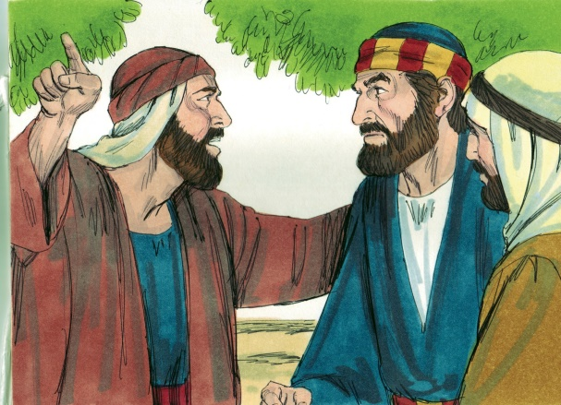
Spirituality and Good Works Doesn’t Guarantee a Long Life
(37) But it happened in those days that she became sick and died.
When they had washed her, they laid her in an upper room. (38) And since Lydda was near Joppa, and the disciples had heard that Peter was there, they sent two men to him, imploring him not to delay in coming to them.
9 miles
It would be like walking from I65 at Cobbs/Ford to the Northern Blvd exit.

Slide 6
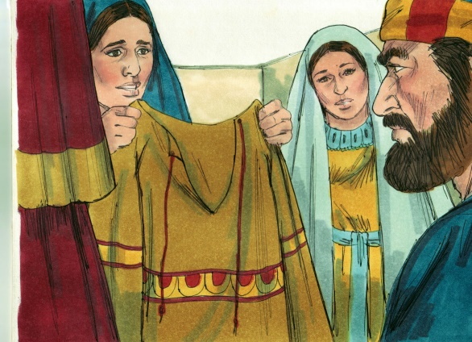
(39) Then Peter arose and went with them. When he had come, they brought him to the upper room. And all the widows stood by him weeping, showing the tunics and garments which Dorcas had made while she was with them.

Slide 7
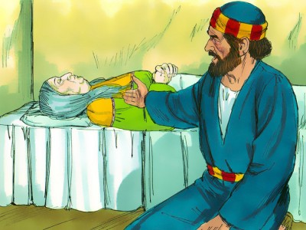
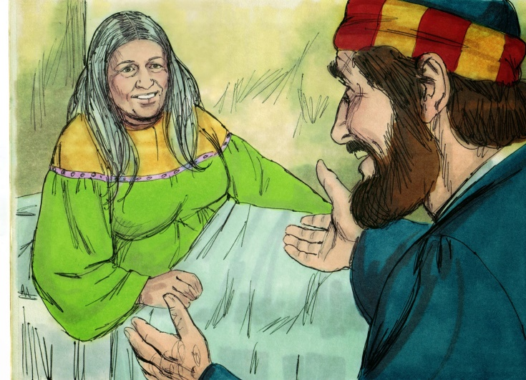
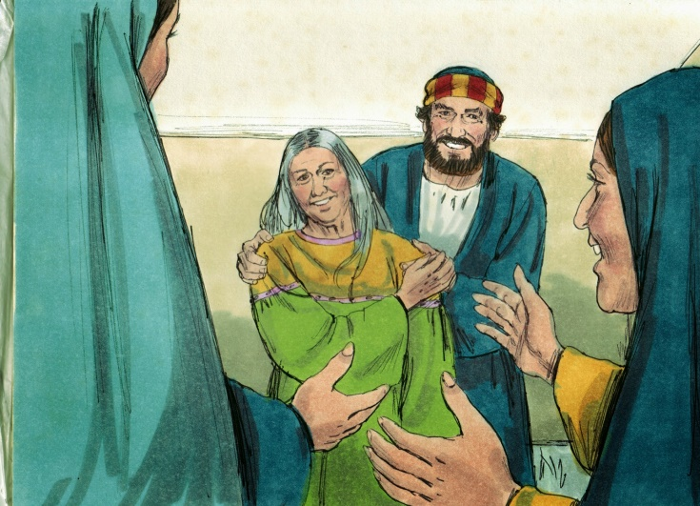
(40) But Peter put them all out, and knelt down and prayed. And turning to the body he said, "Tabitha, arise."
And she opened her eyes, and when she saw Peter she sat up. (41) Then he gave her his hand and lifted her up;
and when he had called the saints and widows, he presented her alive.

Slide 8
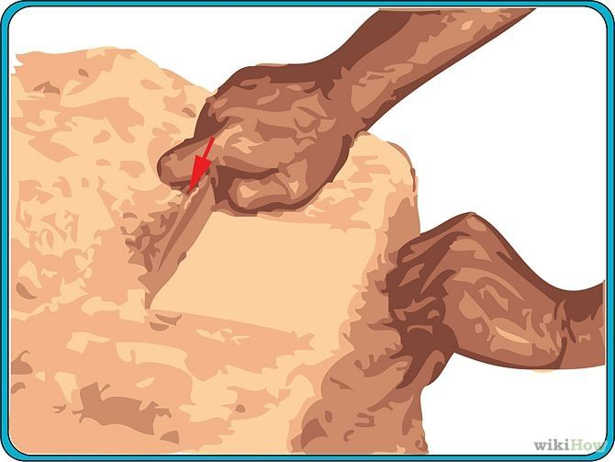
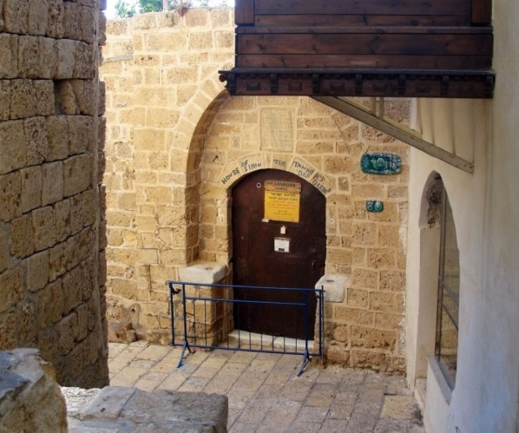
Act 9:42-43 And it became known throughout all Joppa, and many believed on the Lord. (43) So it was that he stayed many days in Joppa (Jaffa today) with Simon, a tanner.

