Slide 1
Saul, Persecutor to Preacher
Act 9:8 Then Saul arose from the ground, and when his eyes were opened he saw no one. But they led him by the hand and brought him into Damascus. 9 And he was three days without sight, and neither ate nor drank.
Notes:
No one asked him to fast. No food or water – One can handle food easily for three days – but water – close to maximum time – Moses 40 days – supernaturally sustained

Slide 2
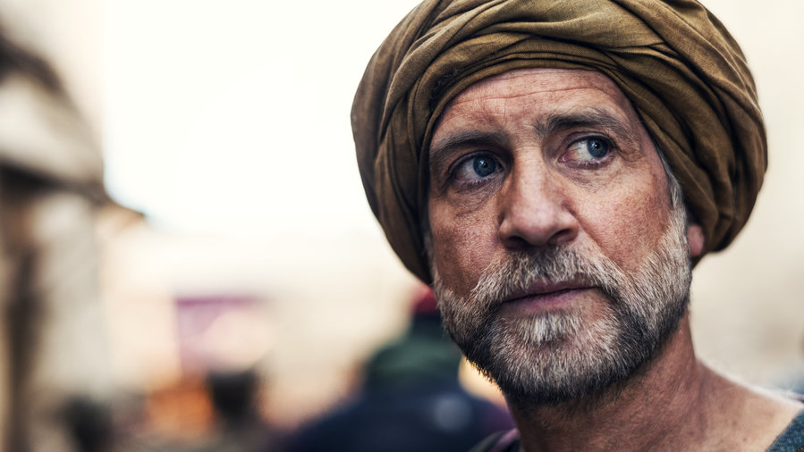
Vision to Vision They Face Each Other
Act 9:10-12 Now there was a certain disciple at Damascus named Ananias; and to him the Lord said in a vision, "Ananias." And he said, "Here I am, Lord." (11) So the Lord said to him, "Arise and go to the street called Straight, and inquire at the house of Judas for one called Saul of Tarsus, for behold, he is praying. (12) And in a vision he has seen a man named Ananias coming in and putting his hand on him, so that he might receive his sight."
Notes:
Why didn’t God send Saul to Ananias?

Slide 3
Bad News Travels Fast
Act 9:13-14 Then Ananias answered, "Lord, I have heard from many about this man, how much harm he has done to Your saints in Jerusalem. (14) And here he has authority from the chief priests to bind all who call on Your name."

Slide 4
Act 9:15 But the Lord said to him, "
Go, for he is a chosen vessel of Mine to bear My name before Gentiles, kings, and the children of Israel. 16 For I will show him how many things he must suffer for My name's sake."

Slide 5
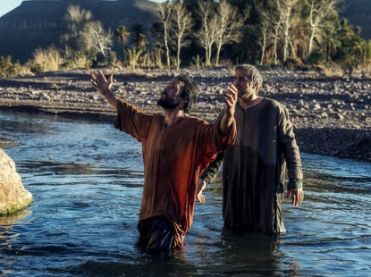
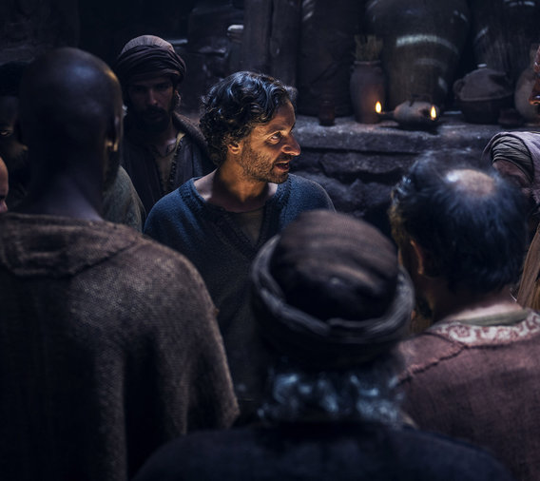
Act 9:17-19 And Ananias went his way and entered the house; and laying his hands on him he said, "Brother Saul, the Lord Jesus, who appeared to you on the road as you came, has sent me that you may receive your sight and be filled with the Holy Spirit." (18) Immediately there fell from his eyes something like scales, and he received his sight at once; and he arose and was baptized. (19) So when he had received food, he was strengthened. Then Saul spent some days with the disciples at Damascus.

Slide 6
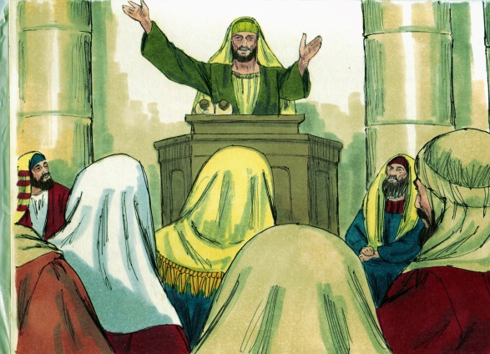
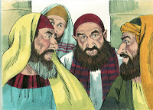
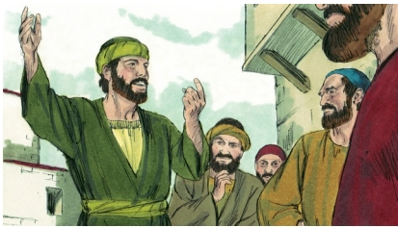
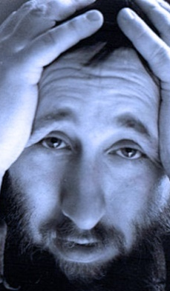
Act 9:20 Immediately he preached the Christ in the synagogues, that He is the Son of God. (21) Then all who heard were amazed, and said,
"Is this not he who destroyed those who called on this name in Jerusalem, and has come here for that purpose, so that he might bring them bound to the chief priests ?"
(22) But Saul increased all the more in strength, and confounded the Jews who dwelt in Damascus, proving that this Jesus is the Christ.
Jesus
The Christ

