Slide 1
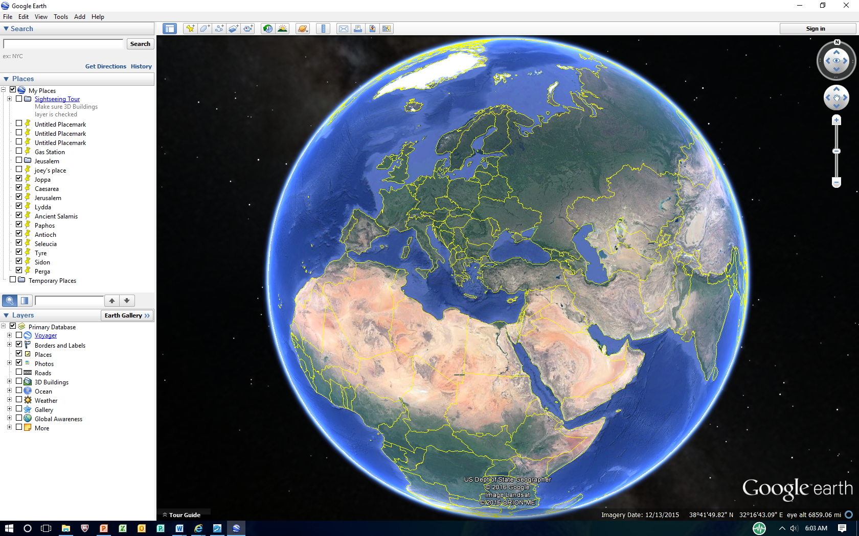
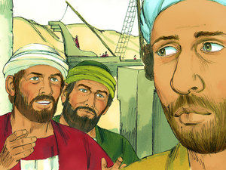
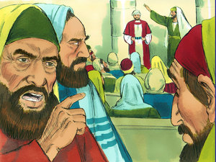
Disappointment, Opportunity and Opposition
In Asia Minor
Acts 13:14-52
Asia Minor

Slide 2
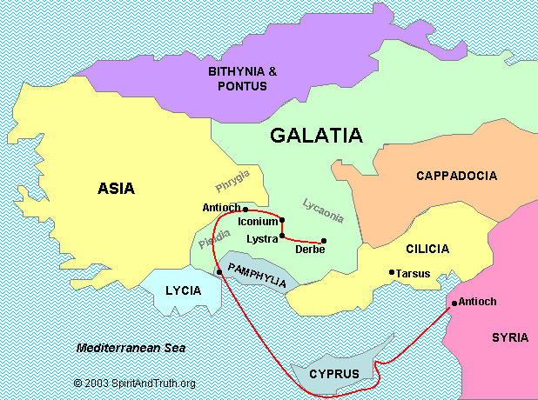
Asia Minor Roman Provinces
Modern Day “Turkey”
Perga
Paul’s first missionary journey

Slide 3
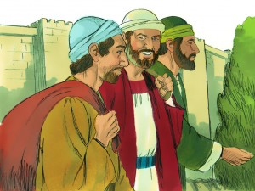
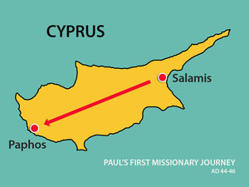
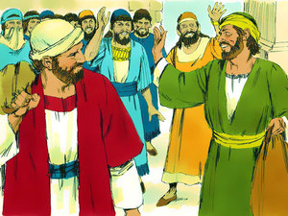
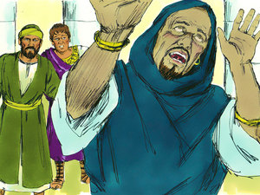
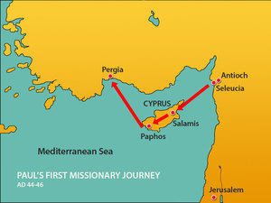
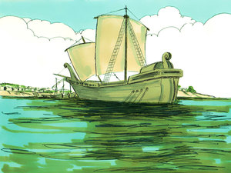
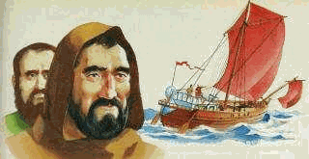
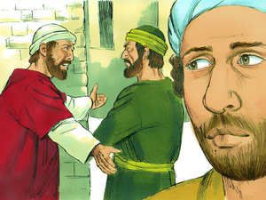
Disappointment
John Mark Bails on Paul and Barnabas
Act 13:13-52 Now when Paul and his party set sail from Paphos, they came to Perga in Pamphylia; and John, departing from them, returned to Jerusalem.
Read – Acts 15:36-38
Because John Mark let Paul down, Paul didn’t want him to go with them again.

Slide 4
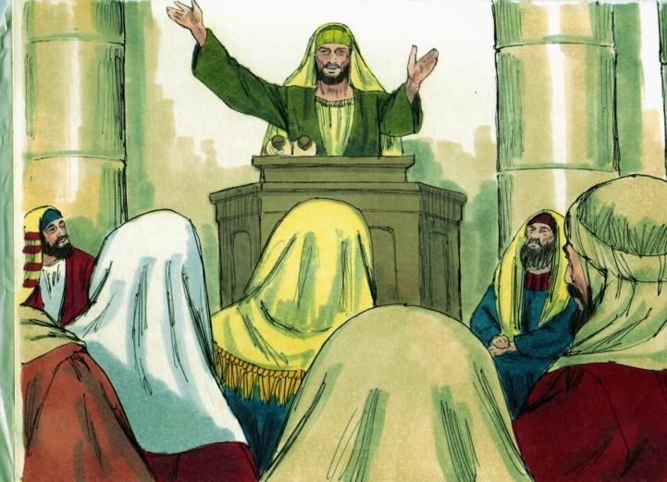
Divine Opportunity
Act 13:14-16 But when they departed from Perga, they came to Antioch in Pisidia, and went into the synagogue on the Sabbath day and sat down. (15) And after the reading of the Law and the Prophets, the rulers of the synagogue sent to them, saying, "Men and brethren, if you have any word of exhortation for the people, say on.“ (16) Then Paul stood up, and motioning with his hand said, "Men of Israel, and you who fear God, listen:

Slide 5
Outline of Paul’s Sermon at Antioch in Pisidia Acts 13:17-25
17-22 - Israel’s History from Egypt to King David
22-23 - The promises given to David were fulfilled in Jesus Christ
24-31 – Historical narrative of Jesus from John the Baptist to His resurrection.
32-37 – All was prophesied by the scriptures
Acts 13:38-41 – Their responsibility to the message

Slide 6
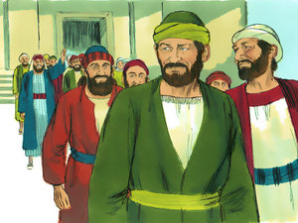
A Great Response
Act 13:42-43 So when the Jews went out of the synagogue, the Gentiles begged that these words might be preached to them the next Sabbath. (43) Now when the congregation had broken up, many of the Jews and devout proselytes followed Paul and Barnabas, who, speaking to them, persuaded them to continue in the grace of God

Slide 7
Opposition
Act 13:44-45 On the next Sabbath almost the whole city came together to hear the word of God. (45) But when the Jews saw the multitudes, they were filled with envy; and contradicting and blaspheming, they opposed the things spoken by Paul.

Slide 8
Rejection of the Gospel is Self Condemnation
Act 13:46-47 Then Paul and Barnabas grew bold and said, "It was necessary that the word of God should be spoken to you first; but since you reject it, and judge yourselves unworthy of everlasting life, behold, we turn to the Gentiles. (47) For so the Lord has commanded us: 'I HAVE SET YOU AS A LIGHT TO THE GENTILES, THAT YOU SHOULD BE FOR SALVATION TO THE ENDS OF THE EARTH.' “ (See Is. 49:6)
=

Slide 9
THE RECEPTION OF THE GOSPEL IS LIFE ETERNAL
Act 13:48-49 Now when the Gentiles heard this, they were glad and glorified the word of the Lord. And as many as had been “appointed” to eternal life believed.

Slide 10
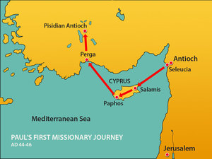
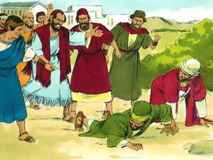
Proclamation and Growth, Persecution
Act 13:49 And the word of the Lord was being spread throughout all the region. 50 But the Jews stirred up the devout and prominent women and the chief men of the city, raised up persecution against Paul and Barnabas, and expelled them from their region.

Slide 11
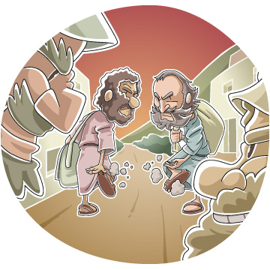
The Right Attitude When The Gospel is Rejected
Act 13:51-52 But they shook off the dust from their feet against them, and came to Iconium. (52) And the disciples were filled with joy and with the Holy Spirit.
The words of Jesus - Mat 10:12-17 And when you go into a household, greet it. (13) If the household is worthy, let your peace come upon it. But if it is not worthy, let your peace return to you. (14) And whoever will not receive you nor hear your words, when you depart from that house or city, shake off the dust from your feet.

